Slide 1
2015 VA ATC Equations
Miranda Wantland
10/29/2014

Slide 2
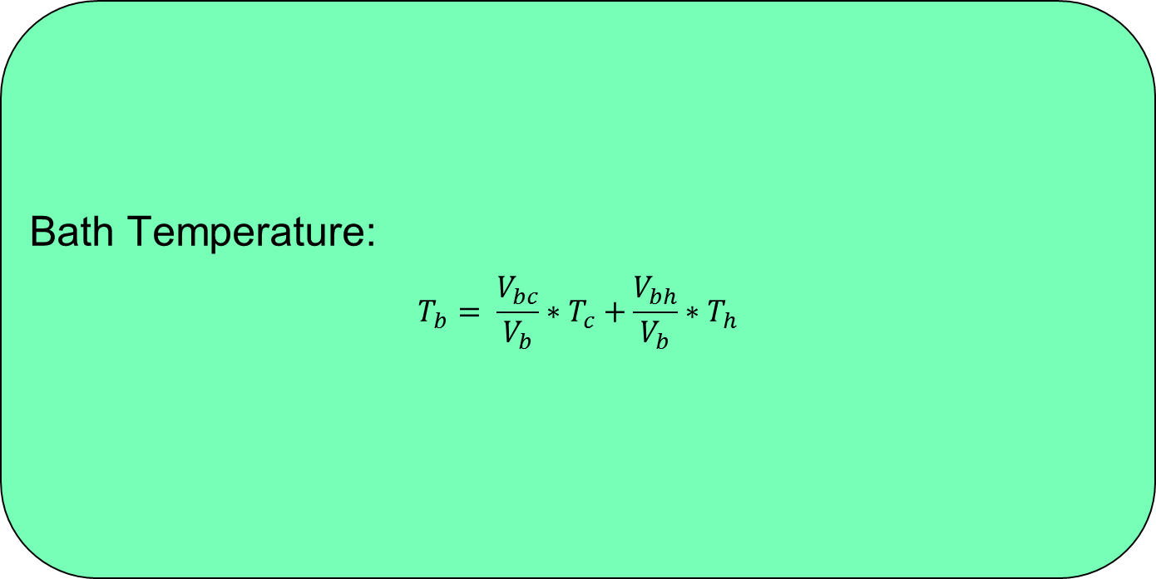
Thermistor ATC
Bath Temperature:
$$T_{b}= \frac{V_{bc}}{V_{b}}∗T_{c}+\frac{V_{bh}}{V_{b}}∗T_{h}$$

Slide 3
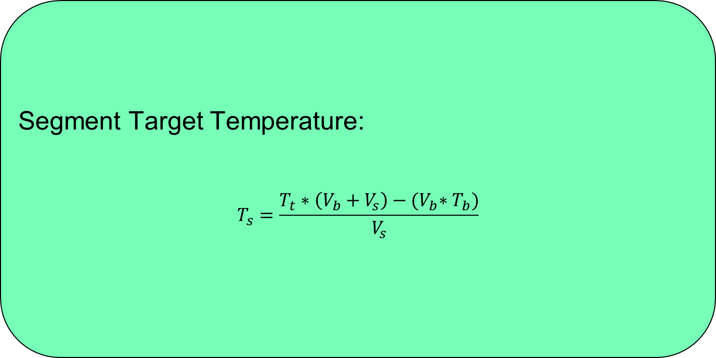
Thermistor ATC
Segment Target Temperature:
$$T_{s}=\frac{T_{t}∗\left(V_{b}+V_{s}\right)−{(V}_{b}∗T_{b})}{V_{s}}$$

Slide 4
Thermistor ATC
Bath Temperature:
$$T_{b}= \frac{V_{bc}}{V_{b}}∗T_{c}+\frac{V_{bh}}{V_{b}}∗T_{h}$$

Slide 5
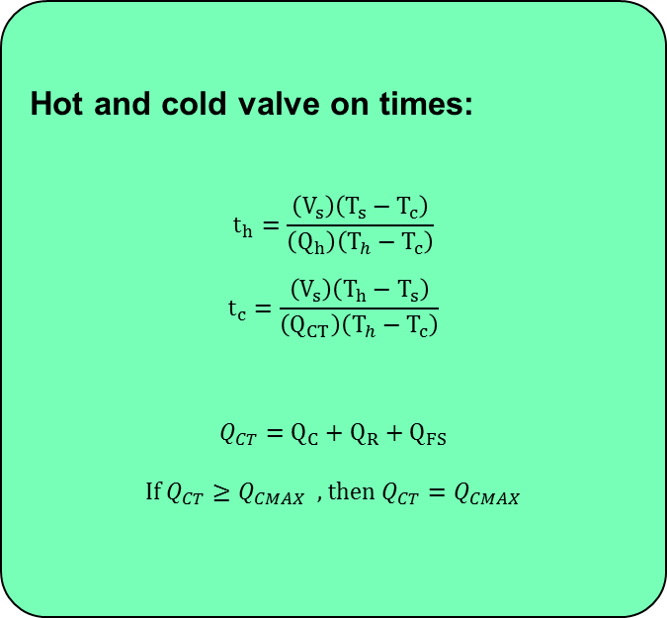
Non-Thermistor ATC
Hot and cold valve on times:
$$t_{h}=\frac{\left(V_{s}\right)\left(T_{s}−T_{c}\right)}{\left(Q_{h}\right)\left(T_{h}−T_{c}\right)}$$
$$t_{c}=\frac{\left(V_{s}\right)\left(T_{h}−T_{s}\right)}{\left(Q_{CT}\right)\left(T_{h}−T_{c}\right)}$$
$$Q_{CT}=Q_{C}+Q_{R}+Q_{FS}$$
If $Q_{CT}≥Q_{CMAX}$, then $Q_{CT}=Q_{CMAX}$
t_{ci}=Cold valve on time (initial segment)
t_{hi}=Hot valve on time (initial segment)
t_{cf}=Cold valve on time (fine segment)
t_{hf}=Hot valve on time (fine segment)
t_{c}=Cold valve on time (ratio)
t_{h}=Hot valve on time (ratio)
t_{hs}=Hot shot time based on UI temperature*
T_{c}=Cold inlet water temperature*
T_{h}=Hot Inlet water temperature*
T_{bath}=Target bath temperature (based on UI temperature)*
Q_{H}=Hot inlet water valve flow rate*
Q_{CT}=Total cold water flow rate*
V_{hs}=hot shot volume (calculated based on hot shot time)
V_{si}=initial segment volume (based on target pressure sensor level)*
V_{sf}=fine segment volume (based on target pressure sensor level)*
Q_{CT}=Total cold water flow rate*
Q_{C}=Cold inlet water valve flow rate*
Q_{R}=Rinse water valve flow rate*
Q_{FS}=Fabric softener inlet water valve flow rate*
*denotes a parametric value or table

Slide 6
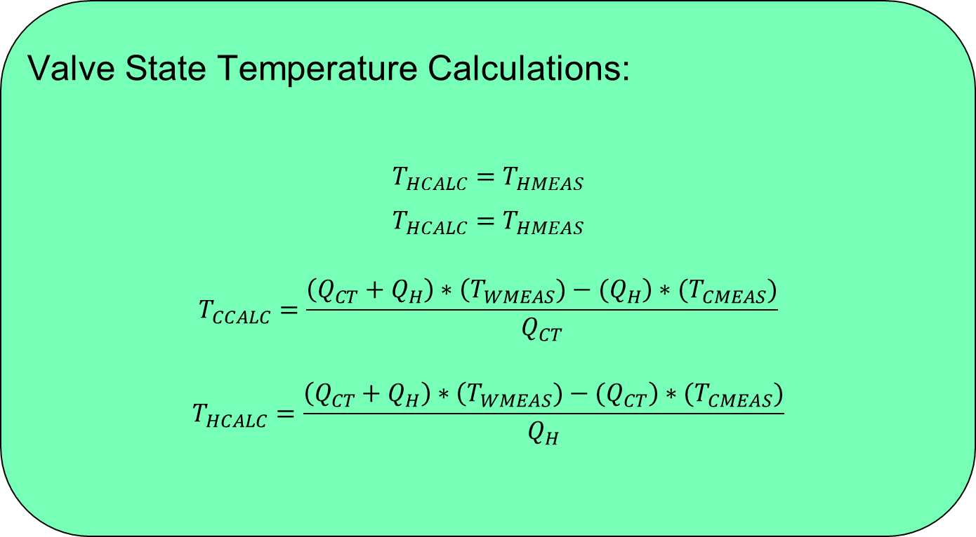
Thermistor ATC
Valve State Temperature Calculations:
$T_{HCALC}=$ $T_{HMEAS}$
$T_{HCALC}=$ $T_{HMEAS}$
$$T_{CCALC}=\frac{\left(Q_{CT}+Q_{H}\right)∗\left(T_{WMEAS})−(Q_{H}\right)∗{(T}_{CMEAS})}{Q_{CT}}$$
$$T_{HCALC}=\frac{\left(Q_{CT}+Q_{H}\right)∗\left(T_{WMEAS})−(Q_{CT}\right)∗{(T}_{CMEAS})}{Q_{H}}$$

Slide 7
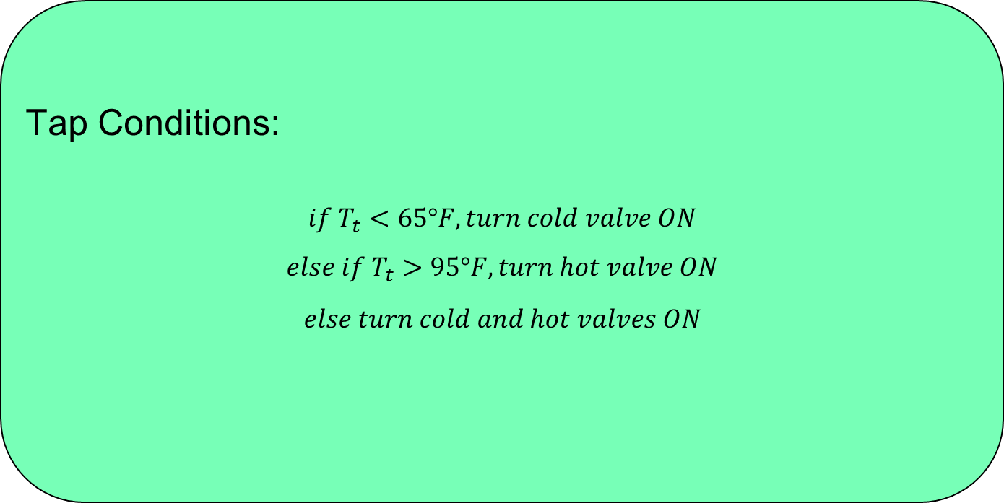
Thermistor ATC
Tap Conditions:
$$if T_{t}<65°F, turn cold valve ON$$
$$else if T_{t}>95°F, turn hot valve ON$$
$$else turn cold and hot valves ON$$

